Slide 1
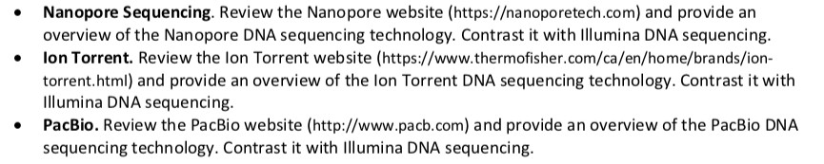
Biochem 3BP3 Advances in DNA Sequencing

Slide 2
Sequencing Trade-Offs
Two sequencing paradigms are currently prevalent
Sanger DNA sequencing (low volume) 500-1200 bp via sequecing by synthesis and fragment migration technologies (gel or capillary)
Illumina DNA sequencing (high volume) 250 bp via massively parallel sequencing by synthesis and optical technologies (i.e. labeled bases)
Choice of technology involves trade-offs:
Length of sequencing reads
Ability to generate mate-pair reads
Volume of sequencing reads
Speed of DNA sequencing
Cost of DNA sequencing
Quality of sequencing reads

Slide 3
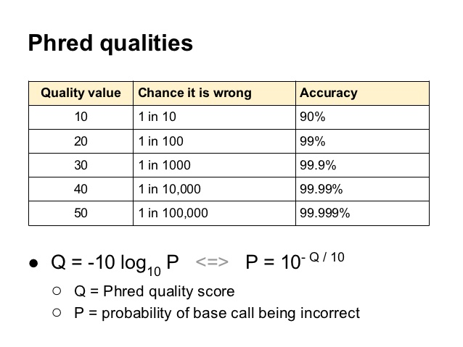
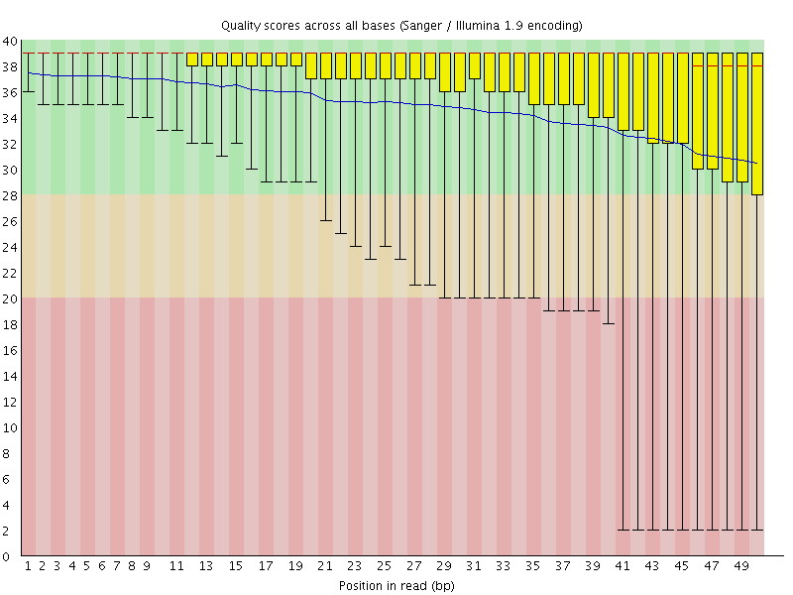
Sequencing Trade-Offs
PHRED quality is a very important concept
Length of read and quality of read are inter-dependent in both Sanger and Illumina sequencing approaches – can this relationship be decoupled?

Slide 4
Sequencing Trade-Offs
Illumina is the dominant technology currently
Short reads, but good quality
Massively parallel and thus high volume
Mate paired
Confidence obtained by high coverage
But Sanger sequencing still considered the gold standard for verification of results, e.g. confirmation of SNPs discovered by exome sequencing
Illumina short read sequencing is not the optimal data for every question
It is perfect for 16S microbiome profiling
It makes genome or transcript assembly very difficult and very noisy
A $1000 human genome is within reach
Exome sequencing of clinical samples is already affordable
But fast, real-time clinical sequencing is not yet possible – speed and infrastructure remain issues

Slide 5
What’s Next – Nanopore MinION
A protein nanopore is set in an electrically resistant polymer membrane
An ionic current is passed through the nanopore by setting a voltage across this membrane
Change in current used to identify the molecule passing through

Slide 6
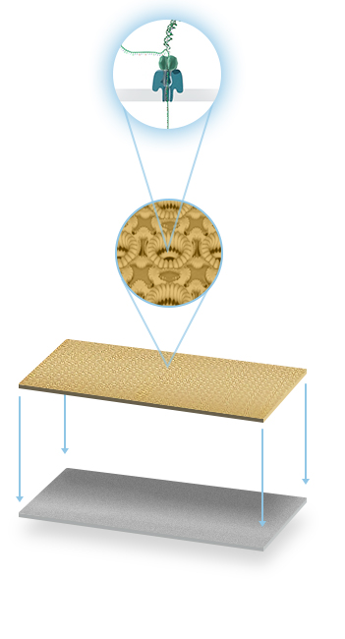
What’s Next – Nanopore MinION
Changes in current can identify bases but also modified bases
Nanopores arrayed on a single chip using microscaffolds and microelectrodes for each nanopore
Each nanopore sequences a single DNA molecule from start to finish – no fixed read length! (longest reported is 200 kb)

Slide 7
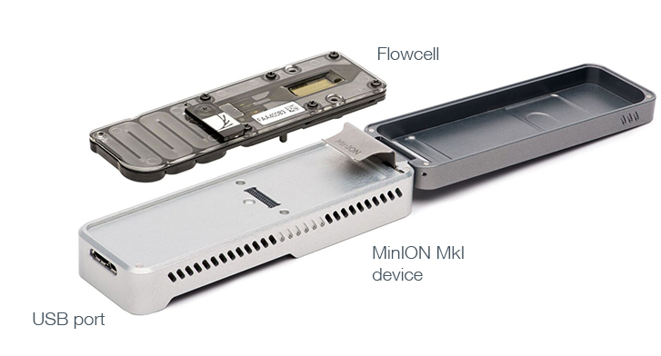
What’s Next – Nanopore MinION
Flowcell and overall device very small and portable
Easy to use – no PCR step involved, submit simple DNA extracts
DNA strand moves rapidly at the rate of 1-5 μs per base through the nanopore
Processing of fast signal not yet mature – higher DNA sequencing error rate than other technologies - per base accuracy of the MinION has been reported as 65 - 80%
Long MinION reads combined with higher quality Illumina read coverage a boon for genome assembly
May be the first technology for clinical virus sequencing and outbreak management

Slide 8
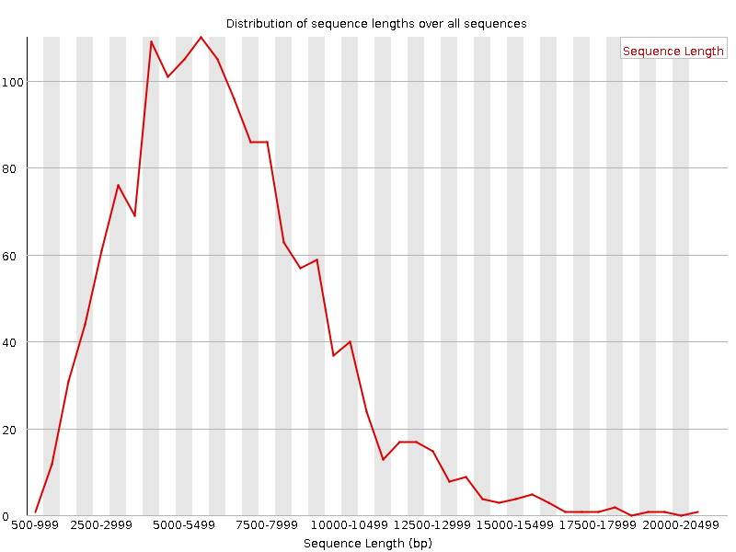
Nanopore Sequence Lengths
1478 total sequences produced by sequencing a bacterial pathogen

Slide 9
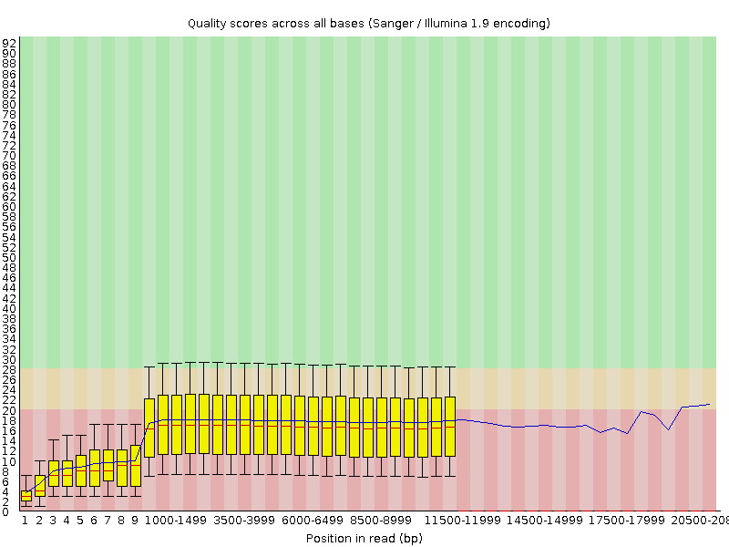
Nanopore Sequence Quality

Slide 10
Nanopore Sequencing - Implications
minION produces 25-42 Gb in 48 hours; proposed PromethION will produce 7-12 Tb in 48 hours (can you hear Kryder weeping?)
Read length and PHRED scores decoupled. Can the PHRED performance be improved?
Complete single pass genome or chromosome sequencing may be possible
Assembly algorithms may not be needed
No PCR or sequencing by synthesis – few consumables – cheaper!
Fast technology – clinical application
Miniature technology – field biology
Density of nanopores may allow sequencing of complete microbiomes
Bacteria & Viruses
Both pathogen identification and gene content
PromethION sequencing of an entire transcriptome?

Slide 11
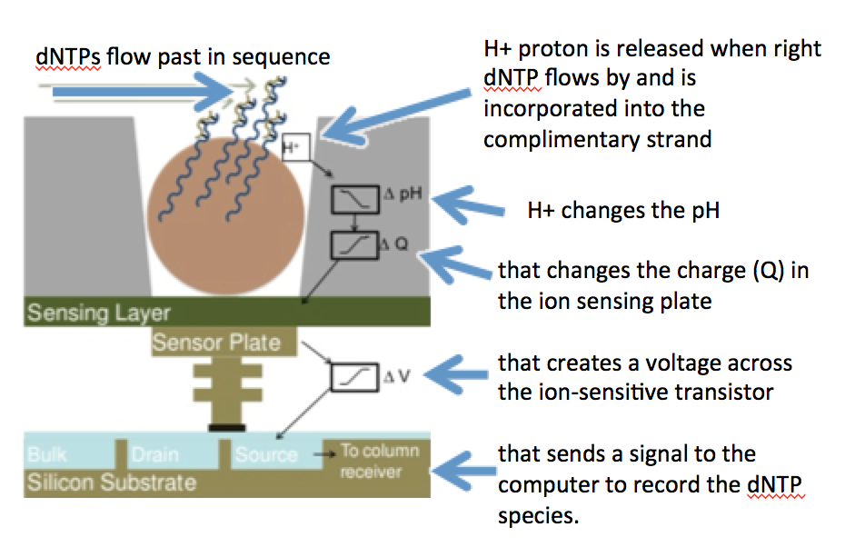
What’s Next – Ion Torrent
Semi-conductor DNA sequencing instead of Illumina optical detection
Still involves sequencing via synthesis so unlikely to be as affordable as nanopore technologies

Slide 12
What’s Next – Ion Torrent
Volume and data are similar to Illumina but…
Mate pairs not possible
PHRED scores not as high
Lower cost per base and faster run time but technology is analogous to Illumina – massively parallel short reads
The need for massively parallel short read technologies is not yet going away, particularly for large complicated RNA/DNA samples
Which technology will persist – optical detection or semi-conductor sequencing?

Slide 13
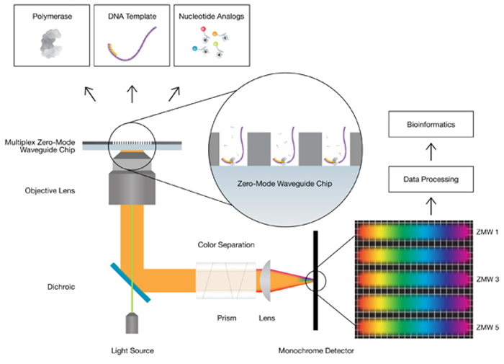
What’s Next – PacBio
Single Molecule, Real-Time (SMRT) technology - claimed long reads, uniform coverage, and high consensus accuracy
Also a sequence by synthesis method with phospholinked nucleotides but has a novel sensor: zero-mode waveguides (ZMWs)
A single DNA polymerase enzyme is affixed at the bottom of a ZMW with a single molecule of DNA as a template

Slide 14
What’s Next – PacBio
As nulceotides are incorporated, the ZMW detects the release of the flourescent tag – sequencing by synthesis
Immobilized DNA polymerase is stable enough for long reads: average > 10,000 bp, some reads > 60,000 bp
Single polymerase – single template sequencing has orders of magnitude less consumable needs than Illumina sequencing by synthesis

Slide 15
What’s Next – PacBio
Cost is still high due to technology costs, but that is expected to drop
PHRED error rates remain higher but each SMRT cell generates ~55,000 reads so error is offset by coverage (except for bias!)
Greatly simplifies the genome sequencing problem, particularly for bacteria
Combined with low volume Illumina sequencing, bacterial genomes can be much more easily resolved

Slide 16
Conclusions
Throughput is going to continue to increase - Kryder’s law is going to be an increasing problem
Long read technologies should lead to easier bioinformatics as they overcome many of the problems of genome or transcript assembly (particularly repeats)
The PHRED paradigm will continue to be important but we will need new PHRED prediction algorithms for each new technology
Are we prepared for bioinformatics where we can completely sequence a human transcriptome or thousands of bacterial genomes in a day? Every undergraduate thesis could generate ‘Big Data’

Slide 17
Next Week
Monday
open review & exam preparation session
essay assignment due at 11:59 pm
Exam is Thursday, December 13th 7:30-9:30 pm

